Slide 1
Climate change group presentation
20 December 2012
Miriam, Johannes, Jolene, and Milan

Slide 2
Outline
1 - Introduction (Miriam and Jolene)
2 - Milan: climate change and democratic legitimacy
3 - Miriam: effectiveness of market-driven governance mechanisms
4 - Johannes: Implications of the German energy-turnaround for the EU
5 - Jolene: Gender and climate change adaptation

Slide 3
1 - Introduction
Science of climate change
Governance
Multilateral agreement failure
Adaptation
‘Localized Knowledge’

Slide 4
Science of climate change
Emissions of greenhouse gases (GHGs) as a result of land use change and burning of fossil fuels is leading to an increase in global temperatures, causing more erratic weather patterns, including draught, flooding, and storms, as well as rising sea levels as the polar ice caps melt.
Time pressure: Emissions accumulate over time, therefore the sooner emissions reductions occur the more effective they will be.

Slide 5
Governance
Unique governance challenge, given that it is one of the few truly global environmental concerns.
  Creates a lot of problems for generating a global agreement.
  Global agreement is considered necessary for emissions reductions to be effective in mitigating climate change, yet it has proven to be an overwhelming challenge.
North/South - Emissions largely come from developed countries in the North, but global warming will affect undeveloped countries in the South the worst because they will have less resources with which to adapt.
  Developing countries are also generally unwilling to undergo the same emissions reductions as developed countries because development is of greater concern for them.
Climate change is fundamentally complex and challenging – fossil fuels are the basis of the industrialised economy and to change that basis requires an overhaul of the entire global economy.
  This is not only an enormous task but it is also fiercely opposed by corporations which stand to lose out.

Slide 6
Multilateral agreement failure
Multilateral agreements have failed to produce a global agreement which sets the stringent targets necessary for effective emissions reductions.
Nevertheless, there is common agreement that rises in global temperatures should be kept below the 2˚C to avoid dangerous climate change.
The Kyoto Protocol set binding obligations on industrialised countries to reduce emissions by 5.2% on average between 2008-2012. The United States did not ratify the agreement, and Canada withdrew in 2011. This is considered to have considerably weakened the protocol.
The Protocol implemented market-driven, cap-and-trade governance mechanisms
  Joint Implementation, the Clean Development Mechanism, and Intergovernmental Emissions Trading

Slide 7
Multilateral agreement failure
Alternative governance mechanisms have emerged in the wake of multilateral treaty failure. These include voluntary carbon markets, city initiatives, and transition towns initiatives.
Matthew Hoffman argues that these experiments have to potential to revitalise and re-imagine the form that global responses to climate change can take, by shifting focus away from multilateral treaty-making as the means to govern climate change and replacing a singular response with multiple responses.

Slide 8
Adaptation
Because of historical emissions, some degree of climate change is now inevitable
Adaptation is the process through which states, cities, and other groupings seek to respond to climatic changes
Some adaptation mechanisms risk making the problem worse: air conditioning to deal with extreme heat, energy-intensive desalination, etc

Slide 9
2 - Milan: climate change and democratic legitimacy
There is a growing literature on climate ethics
We are making irrevocable choices on behalf of future generations
This challenges the legitimacy of democratic governments, especially with regard to their choices on energy

Slide 10
Climate ethics literature
During the last ten years or so, moral and political philosophers have devoted considerable energy to evaluating the normative characteristics of climate change
These scholars include Henry Shue, Stephen Gardiner, Simon Caney, Dale Jamieson, and others
Topics that have been examined include climate economics (Stern and Garnaut reviews, etc), intergenerational ethics, cosmopolitanism and responsibility, human rights, intragenerational ethics and development, adaptation, geoengineering, personal responsibility, etc

Slide 11
Climate ethics literature
I plan to focus on one area of this discussion: how what we are learning about climate change affects the legitimacy of democratic governments
Legitimacy: The general perception that the restrictions placed by government on the choices of individuals are non-arbitrary and grounded in some theory of representation and due process
  Also, the premises and logic that support this perception
  Perhaps most importantly: the concept of the consent of the governed

Slide 12
What is the normative basis for the rule of democratic governments?
Why do people accept the restriction of their choices by the state?
Why is this restriction generally perceived as legitimate?
One key reason is the perception that democratically elected governments rule over a population that has consented to their rule, and which has input into their decisions
This dynamic does not hold for members of future generations affected by climate change
Their role in our political system is only as victims: not as participants or granters of consent

Slide 13
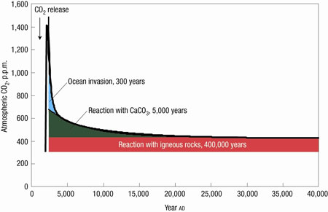
Our emission choices cast a long shadow

Slide 14
Parallels where a group is a passive target of the will of another group
Slavery
Colonialism
Shue: The claim that we are treating future generations unjustly does not depend on certainty about the impacts of climate change
At this point, there is ample scientific documentation of the risks
Imposing a high level of climate change on future generations is akin to playing Russian Roulette with their heads – unethical even if they ‘win’

Slide 15
This is not just theoretical
“Climate change presents a unique challenge for economics: it is the greatest and widest-ranging market failure ever seen.”
  Stern Review on the Economics of Climate Change, 2006
Those alive today get the benefits associated with fossil fuel use, while the risks and harms associated with GHG emissions largely fall on those who do not benefit
  Both intra- and inter-generationally

Slide 16
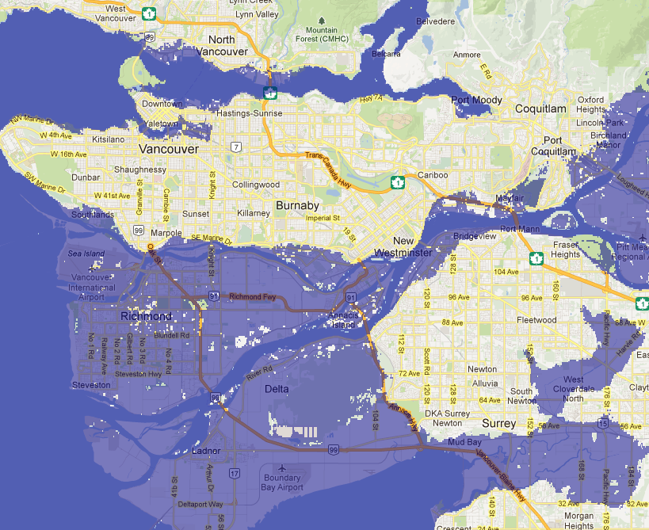

Slide 17
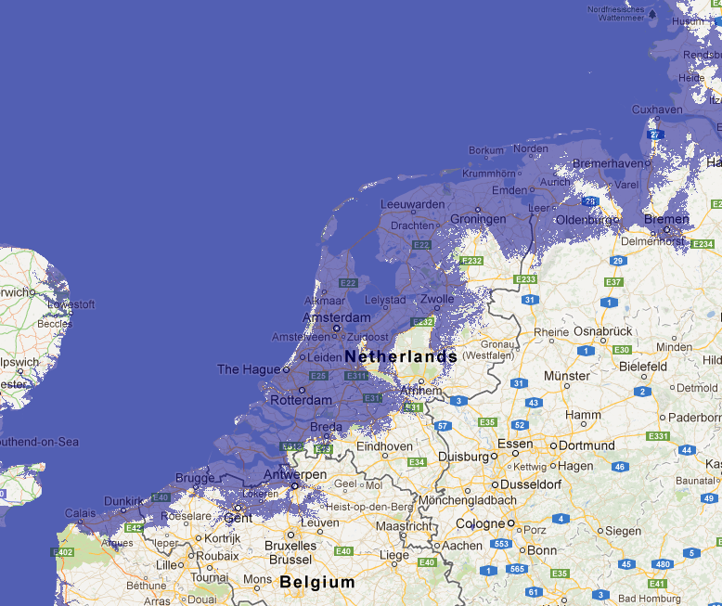

Slide 18
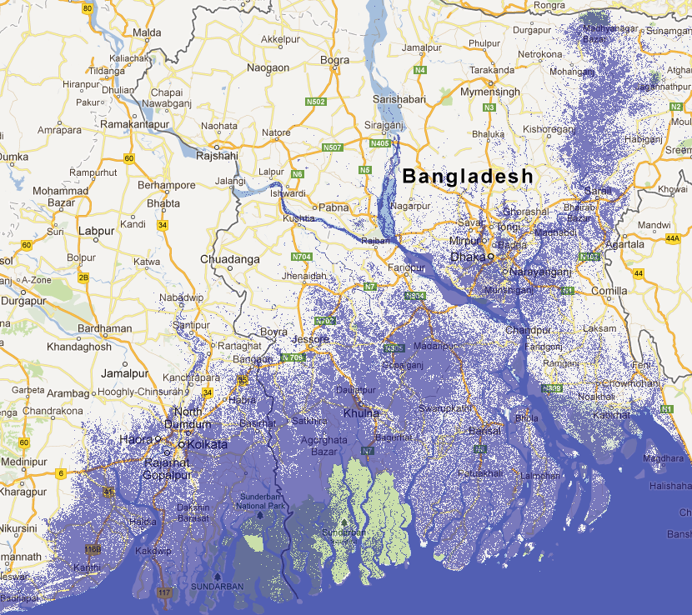

Slide 19
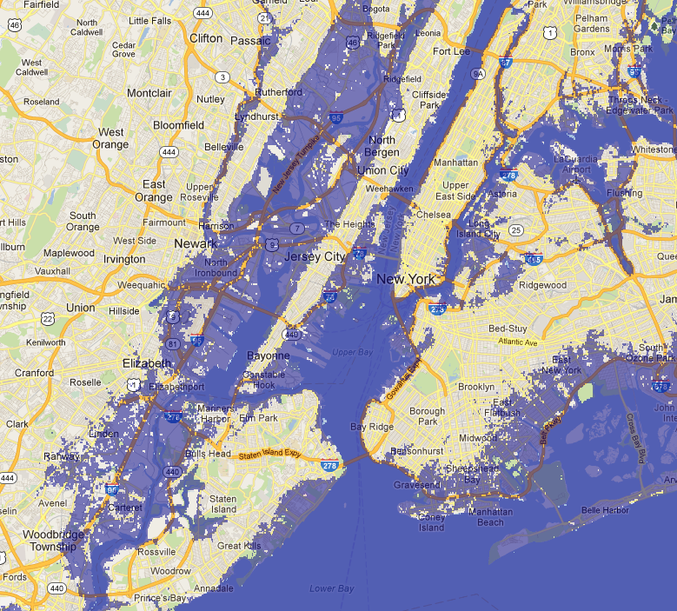

Slide 20
Danger of moral corruption
“In the perfect moral storm, our position is not that of idealized neutral observers, but rather judges in our own case, with no one to properly hold us accountable. This makes it all too easy to slip into weak and self-serving ways of thinking, supported by a convenient apathy or ideological fervor. Moreover, the devices of such corruption are sophisticated, and often function indirectly, by infiltrating the terms of ethical and epistemic argument”
  Stephen Gardiner, 2011

Slide 21
Danger of false solutions
“Given this, we are susceptible to proposals for action that do not respond to the real problem. This provides a good explanation of what has gone wrong in the last two decades of climate policy, from Rio to Kyoto to Copenhagen. However, the form of such ‘shadow solutions’ is likely to evolve as the situation deteriorates. Some recent arguments for pursuing geoengineering may represent such an evolution.”
  Stephen Gardiner, 2011

Slide 22
To sum up
Climate change raises important ethical issues
In particular, the behaviour of our generation toward future generations is a target for normative analysis
Because democratic governments are only supported by members of one generation – but make choices that affect thousands of generations – the legitimacy of democratic choices on GHG emissions is widely overestimated

Slide 24
3 - Miriam: effectiveness of market-driven governance mechanisms

Slide 25
4 - Johannes: Implications of the German energy-turnaround for the EU

Slide 26
5 - Jolene: Gender and climate change adaptation

Slide 27
Gendering Climate Change Adaptation
Knowledge, Power, and Contestation: Feminist Debates on Gender and Climate Change Adaptation

Slide 28
Overview
Climate change: mitigation and adaptation
  UNFCCC: Commitment to assisting the most vulnerable adapt to climate change; commitment to provide financial assistance to Non-Annex countries
  The Adaptation Fund (which emerged through the Kyoto Protocol): “The Adaptation Fund finances projects and programs to help developing countries adapt to the negative effects of climate change.”
  IPCC Fourth Assessment Report (2007): largely omits gender but acknowledges gender roles impact people’s capacity to adapt to climate change
Responses
  Calls for global funding and adaptation strategies
  The equity dimensions of climate change
  Climate justice framework and translocal organizing around summits like Copenhagen
  “Climate justice” and “No Climate Justice Without Gender Justice”
Notes:
The Adaptation Fund (which emerged through the Kyoto Protocol). “The Adaptation Fund finances projects and programs to help developing countries adapt to the negative effects of climate change.” (This funds grassroots a variety of initiatives, including grassroots initiatives)

Slide 29
NGOs and IGOs: Gender and Climate Change Toolkits
WEDO (in partnership with Oxfam America): http://www.wedo.org/wp-content/uploads/CCWOMENFactsheet-final.pdf
United Nations: http://www.un.org/womenwatch/downloads/Resource_Guide_English_FINAL.pdf (Chapter 4 focuses specifically on adaptation)
Gender CC: http://www.gendercc.net/fileadmin/inhalte/Dokumente/Tools/toolkit-gender-cc-web.pdf
ISIS: http://www.isiswomen.org/index.php?option=com_content&view=article&id=1530:gender-and-climate-change-toolkit-for-women-on-climate-change&catid=168:publication
FAO: http://www.fao.org/climatechange/49379/en/

Slide 30
Gender as an analytical lens
Understanding gender as:
  Non-essentialized
  Socially constructed
  Intersectional
Gender and vulnerability
Gender and agency
Gender and decision-making
“… any attempt to tackle climate
change that excludes a gender analysis will be insufficient, unjust, and therefore unsustainable.”
- (Sherilyn MacGregor, A Stranger Silence Still: the Need for Feminist Social Research on Climate Change, 2010.)

Slide 31
Literature review
  Using perspectives from:
    feminist political ecology,
    critical geography,
    gender and development,
    postcolonial theory,
    environmental injustice scholarship,
    feminist and neo-Gramscian perspectives on international relations
  Bridging work: where research is being conducted
  Also drawing on some of the toolkits on gender and climate change
Notes:
Political ecology is often a mash-up of these subfields I have listed.

Slide 32
Summary
A gender-lens is important for understanding equity dimensions of climate change and responses to it, in terms of mitigation and adaptation. While discussions of mitigation are out of the scope of this paper, I am arguing for a feminist analysis of the effects of climate change and adaption frameworks.
What are the possibilities of transnational and trans-local feminist organizing and solidarity-building to respond to the need for adaptation, while understanding adaptation as a contested and power-laden process?
In this paper I will explore how the trans-local fits into the global terrain of climate governance and how perspectives from feminist political ecology, critical geography, and feminist international relations can help provide a framework for conceptualizing adaptation in critical ways, to best respond to the realities and knowledges of those most vulnerable to climate change.
Notes:
A gender-lens is important for understanding human dimensions of climate change and responses to it, in terms of mitigation and adaptation. While discussions of mitigation are out of the scope of this paper, I am arguing for a feminist analysis of the effects of climate change and adaption frameworks.
What are the possibilities of transnational and trans-local feminist organizing and solidarity-building to respond to the need for adaptation, while understanding adaptation as a contested and power-laden process?
In this paper I will explore how the trans-local fits into the global terrain of climate governance and how perspectives from feminist political ecology, critical geography, and feminist international relations can help provide a framework for conceptualizing adaptation in critical ways, to best respond to the realities and knowledges of those most vulnerable to climate change.

Slide 33
Contesting adaptation
The depoliticization of climate change: moving from mitigation to adaptation
A critical lens: “Adaptation is fundamentally a process that is mediated through power and knowledge (Foucault 1980) and as such it is not a quality or characteristic held by individuals and societies. It is a dynamic process that brings together social inequalities, power, knowledge, geo-politics and day-to-day interactions that are far more complex than the present use of the term adaptation.”
  “…need to take into account how social and ecological systems co-emerge, and understand adaptation as a contested, power-laden process.” (Nightingale, 85)

Slide 34
Adaption: “Traditional and localized knowledge”
Calls for understanding other forms of knowledge of environments and climate change
What are the challenges and the dilemmas of including these knowledges in global frameworks of climate change adaptation?
  Not taking into account people as decision makers
  Relegating indigenous knowledge to “traditional”
  The dominance of scientific and technocratic perspectives on climate change and their primacy in policy-making
  Generalized climate models
  Depoliticzing and ignoring the causes of climate change
  Viewing women’s agency in such a way that essentializes their connection to the environment and places an added burden onto women in climate change mitigation

Slide 35
Emerging solidarities: Organizing around climate conferences
Articulating Climate Justice in Copenhagen: Antagonism, the Commons and Solidarity:
“… climate justice politics generates solidarities between differently located struggles and these solidarities have a potential to shift the terms of the debate on climate change.”

Slide 36
Conclusion

